Slide 1

Huazhong University of Science and Technology
The Department of Electronics and Information Engineering
Electronic Circuit Analysis and Design
Electronic Circuit Analysis and Design
Dr. Tianping Deng
Email: dengtp@hust.edu.cn

Slide 2
Contents
PART 1 SEMICONDUCTOR DEVICES AND BASIC APPLICATIONS
Chapter 1 Semiconductor Materials and Diodes
Chapter 2 Diode Circuits
Chapter 3 The Field-Effect Transistor
Chapter 4 Basic FET Amplifiers
Chapter 5 The Bipolar Junction Transistor
Chapter 6 Basic BJT Amplifiers
Chapter 7 Frequency Response
Chapter 8 Output Stages and Power Amplifiers
PART 2 ANALOG ELECTRONICS
Chapter 9 Ideal Operational Amplifiers and Op-Amp Circuits
Chapter 10 Integrated Circuit Biasing and Active Loads
Chapter 11 Differential and Multistage Amplifiers
Chapter 12 Feedback and Stability
Chapter 13 Operational Amplifier Circuits
Chapter 14 Nonideal Effects in Operational Amplifier Circuits
Chapter 15 Applications and Design of Integrated Circuits
Chapter 4 Basic FET Amplifiers

Slide 3
Ch4 Basic FET Amplifiers
4.1 The MOSFET Amplifier
4.2 Basic Transistor Amplifier Configurations
4.3 The Common Source Amplifier
4.4 The Common Drain（Source Follower） Amplifier
4.5 The Common Gate Configuration
4.5.1 Small voltage and current gains
4.5.2 Input and output Impedance
4.6 The Three Basic Amplifier Configuration:
Summary and comparison

Slide 4
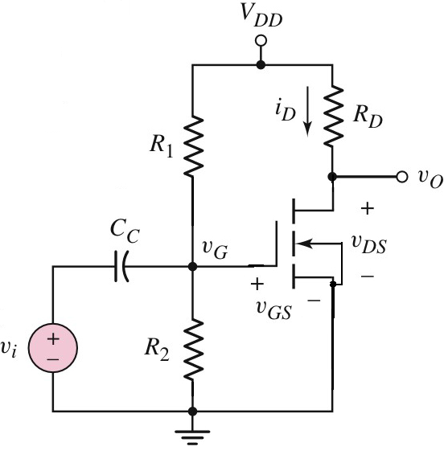
4.2 Basic Transistor Amplifier Configurations
Common source
CS
Common Drain
Common gate

Slide 5
Ch4 Basic FET Amplifiers
4.1 The MOSFET Amplifier
4.2 Basic Transistor Amplifier Configurations
4.3 The Common Source Amplifier
4.4 The Common Drain（Source Follower） Amplifier
4.5 The Common Gate Configuration
4.5.1 Small voltage and current gains
4.5.2 Input and output Impedance
4.6 The Three Basic Amplifier Configuration:
Summary and comparison

Slide 6
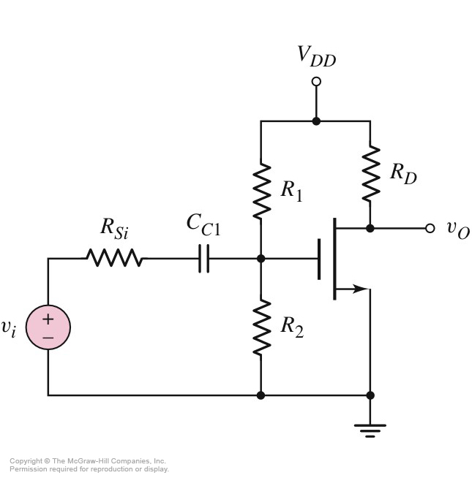
4.3 The Common Source Amplifier
DC analysis:
Coupling capacitor is assumed to be open.
AC analysis:
Coupling capacitor is assumed to be a short.
DC voltage supply is set to zero volts.
Fig.4.14
CS

Slide 7
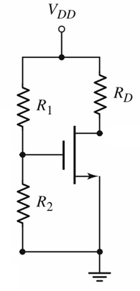
4.3 The Common Source Amplifier
DC circuit
Open
Fig.4.14

Slide 8






4.3.1 A Basic Common Source Configuration
2-port Networks equivalent input impedance
Fig.4.14

Slide 9
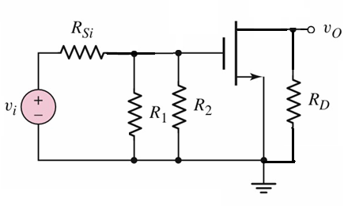

4.3.1 A Basic Common Source Configuration
AC circuit
Set Zero
Short
Fig.4.14

Slide 10
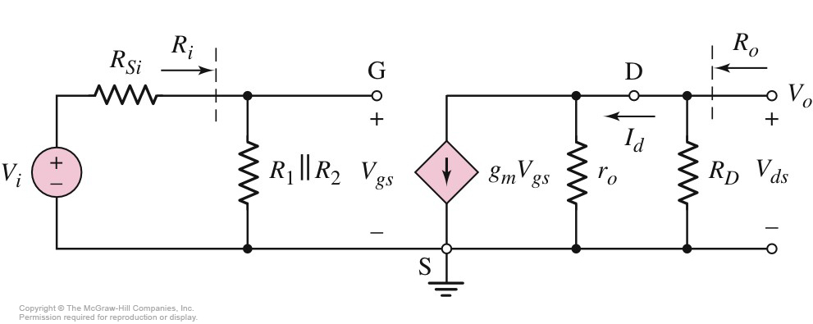
4.3.1 A Basic Common Source Configuration
AC circuit
Small-Signal Equivalent Circuit

Slide 11
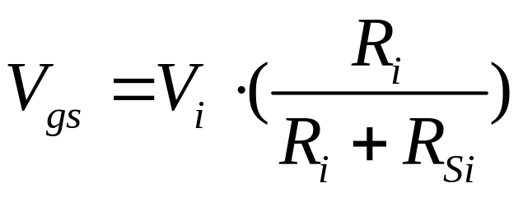
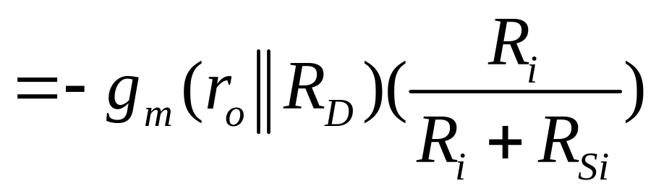
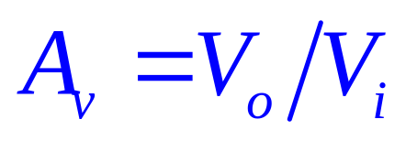
4.3.1 A Basic Common Source Configuration
V_{o} =－g_{m} •V_{gs} •(r_{o}//R_{D})

Slide 12
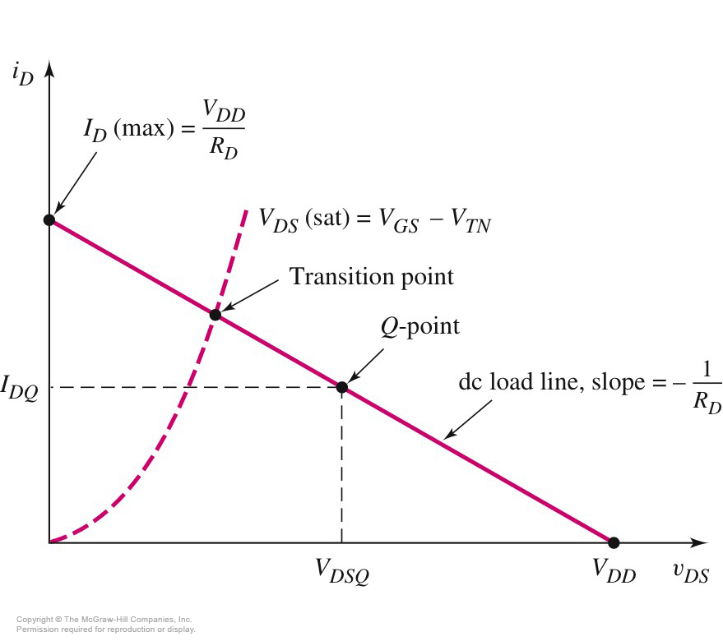
4.3.1 A Basic Common Source Configuration
Q-point near the middle of the saturation region for maximum symmetrical output voltage swing,.
Fig.4.14
Small AC input signal for output response to be linear.

Slide 13

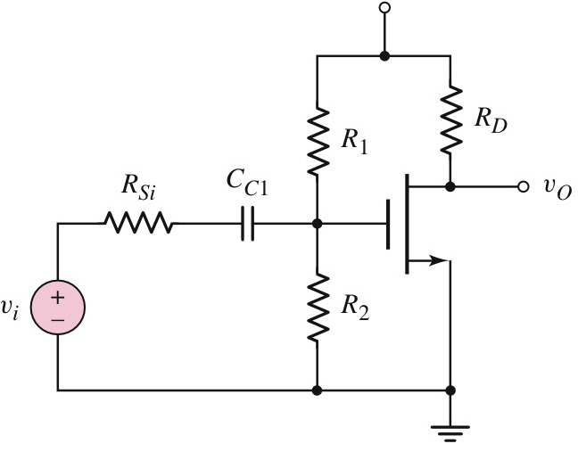
4.3.1 A Basic Common Source Configuration
V_{DD}=10V
R₁=70.9kΩ，R₂=29.1kΩ
R_{D}=2.5kΩ
V_{TN}=1.5V
K_{n}=0.50mA/V²
λ=0.01V^{－1}
R_{Si}=2.5kΩ
SOL：
DC Analysis

Slide 14
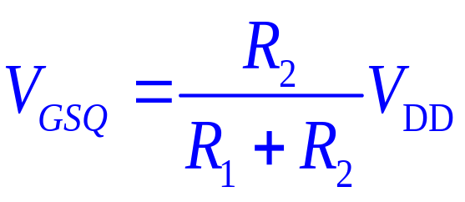
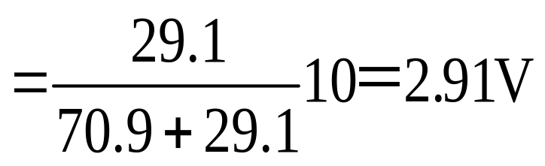
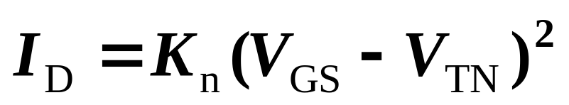
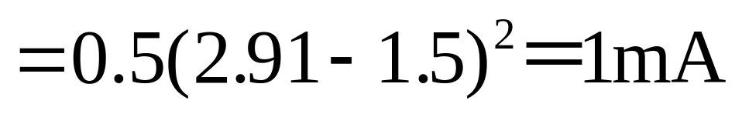
4.3.1 A Basic Common Source Configuration
V_{DD}=10V
R₁=70.9kΩ
R₂=29.1kΩ
R_{D}=5kΩ
V_{TN}=1.5V
K_{n}=0.50mA/V²
λ=0.01V^{－1}
R_{Si}=4kΩ
SOL：
DC Analysis
V_{DS} =V_{DD}- I_{D} R_{D}
V_{DSQ} =5V> V_{GS}-V_{TN}
=2.91-1.5=1.41V
=10－(1)(5)＝5V
Saturation region

Slide 15
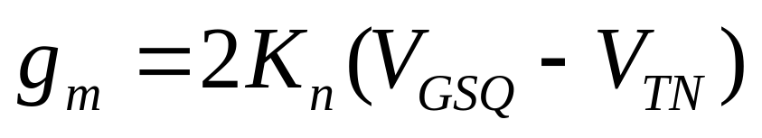
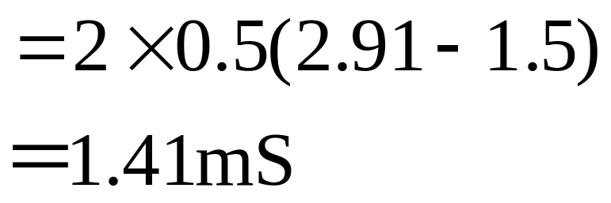
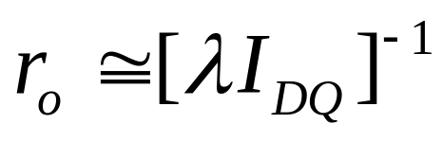
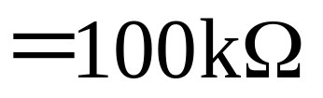
4.3.1 A Basic Common Source Configuration
V_{DD}=10V
R₁=70.9kΩ，R₂=29.1kΩ
R_{D}=2.5kΩ
V_{TN}=1.5V
K_{n}=0.50mA/V²
λ=0.01V^{－1}
R_{Si}=2.5kΩ

Slide 16
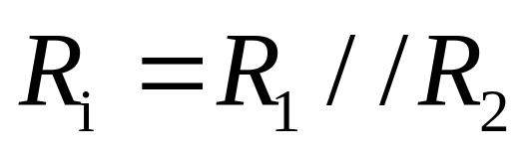
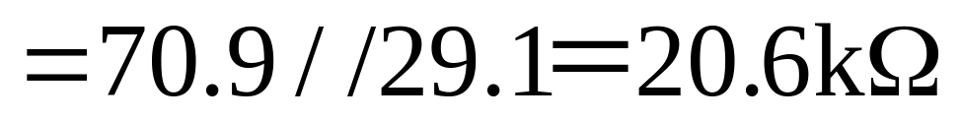

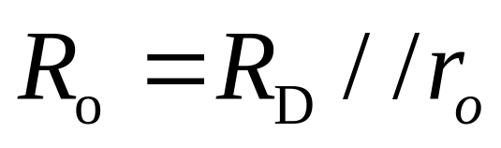
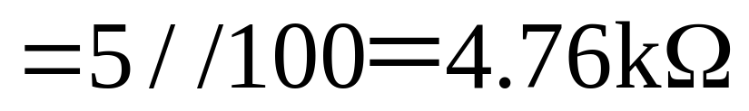

4.3.1 A Basic Common Source Configuration

Slide 17
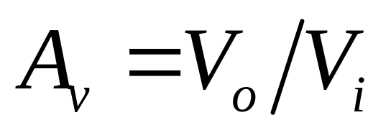
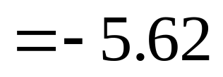
4.3.1 A Basic Common Source Configuration
V_{o} =－g_{m} •V_{gs} •(r_{o}//R_{D})

Slide 18
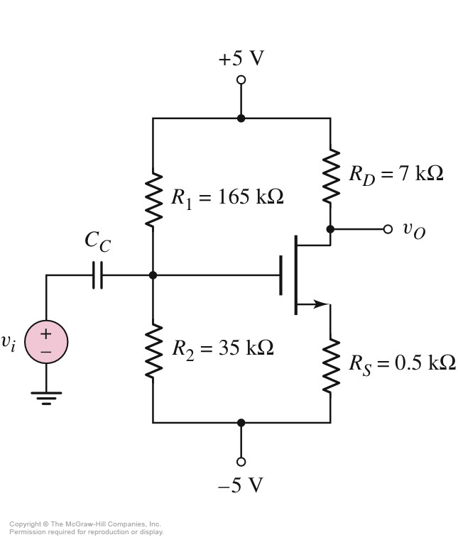
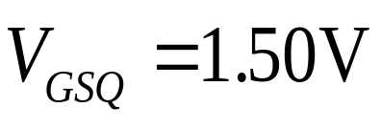
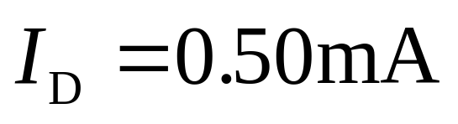

4.3.2 Common Source Amplifier with Source resistor
SOL：
DC Analysis
V_{TN}=0.8V
K_{n}=1mA/V²
λ=0
V_{DS} =6.25V
=1.4mS
Fig.4.19

Slide 19
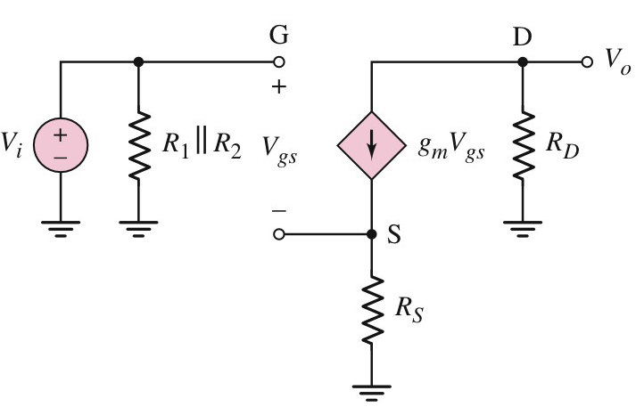
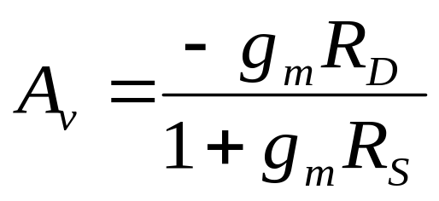
4.3.2 Common Source Amplifier with Source resistor
Small-Signal Equivalent Circuit
V_{TN}=0.8V
K_{n}=1mA/V²
λ=0
V_{o} =－g_{m} •V_{gs} •R_{D}
V_{i} = V_{gs} + g_{m} •V_{gs} •R_{S}

Slide 20
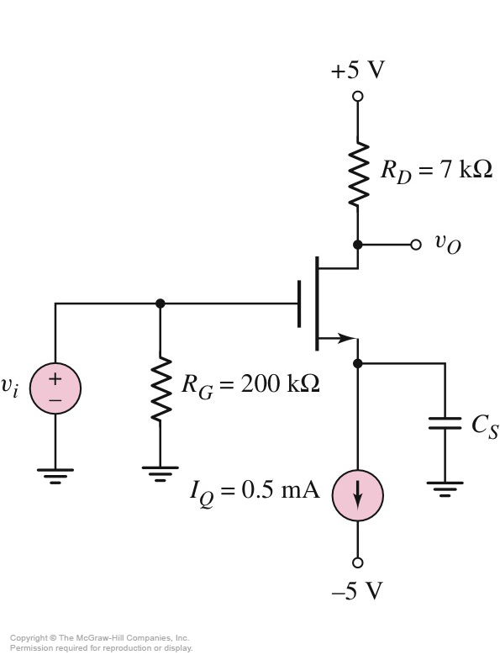
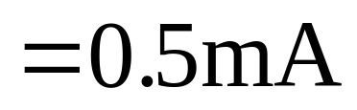
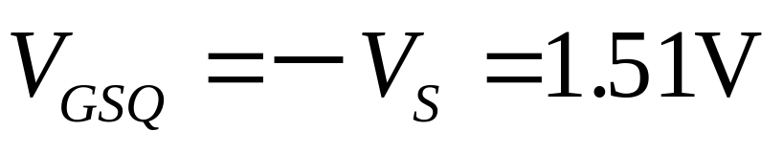
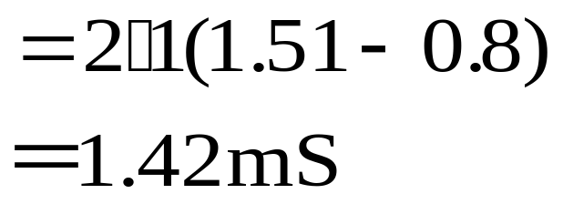
4.3.3 Common Source Circuit with Source bypass Capacitor
SOL：
DC Analysis
V_{TN}=0.8V
K_{n}=1mA/V²
λ=0
V_{DS} =V_{DD}－I_{D} R_{D} －V_{S}
=3.01V
V_{DSQ} =3.01V > 1.51－0.8
=0.71V
Current Source

Slide 21
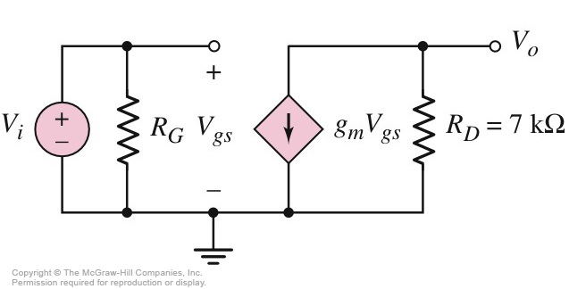
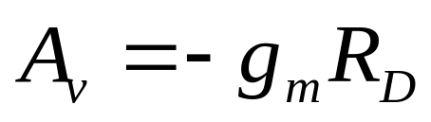
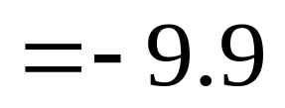
4.3.3 Common Source Circuit with Source bypass Capacitor
V_{TN}=0.8V
K_{n}=1mA/V²
λ=0
Small-signal equivalent circuit
V_{o} =－g_{m} •V_{gs} •R_{D}

Slide 22
Questions
and
Answers

